Slide 1
American diversity

Slide 2
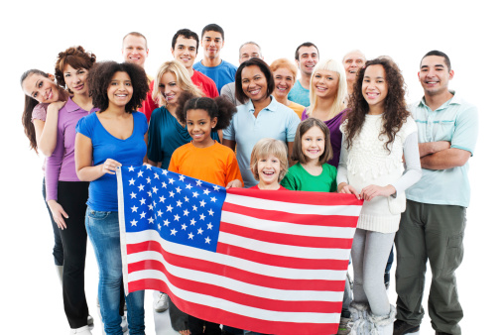
Celebrating America's Diversity
The United States is one of the most ethnically diverse countries in the world. Throughout its history, waves of immigrants have arrived and added to the rich diversity of cultural traditions. One way that Americans' ethnic diversity is expressed is through cultural festivals and celebrations. This expedition focuses on five different celebrations-Crow Fair, Juneteenth, Cinco de Mayo, Chinese New Year, and Mardi Gras-to explore America's ethnic diversity.

Slide 3
Before watching
What is a festival?
What interesting festivals in Russia do you know?
What are the popular holidays celebrated in all countries?

Slide 4
While watching
What is Crow Fair?
How has immigration had an impact on American culture?
What can we learn about a culture through its festivals and celebrations?
When was Chinese New Year first celebrated in the United States?

Slide 5
After watching
What is Mardi Gras?
In which city was Mardi Gras an annual tradition by the 1700s
Why do you think Mardi Gras has been celebrated in Louisiana for so long?

