Slide 1
Задания на отработку навыков письменной речи для школьников по английскому языку
Чернышова Анна

Slide 2
Задания на «зашифровку» письма в стиле смс:
  2day
  B
  8
  c
  4
  r
  2
  U
  Activ8
  Gr8
  B4

Slide 3
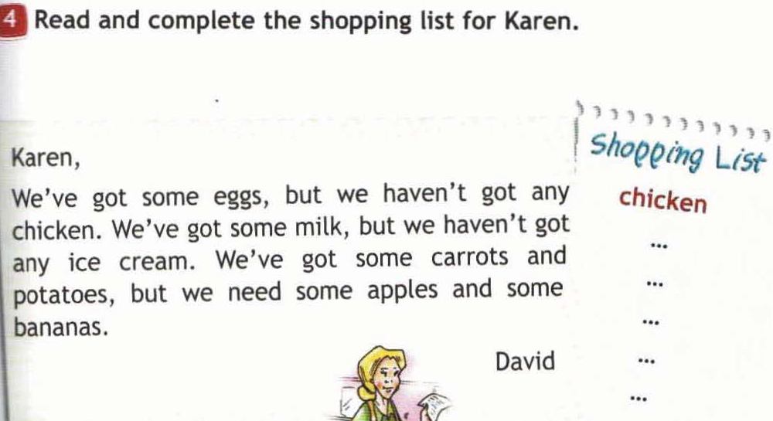
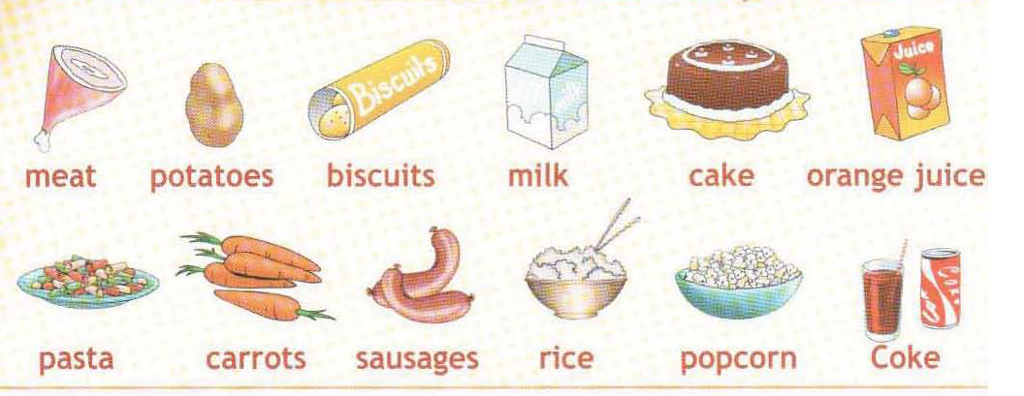

Slide 4
Match the scheme.
1………………………
2……………………...
3………………………...
4.............................................
5…………………………………………………………………………
…………………………………………………………………………..
…………………………………………………………………………..
6…………………………………………………
7……………………
8…………………..
- Письмо (рассказ о себе, семье, ответы на вопросы).
Текст нужно разделить на абзацы.
- Свой адрес (название города или страны)
- Подпись автора (Kate).
- Дата (20 February 2007; May 11, 2007; 15th October 2007)
- Завершающая фраза. (Best wishes. All the best)
- Обращение (Dear Ann,)
- Окончание письма. (I'll write again soon.)
- Благодарность за ранее полученное письмо (Thanks for your letter).

Slide 5
1. Waiting for your letter.
2. Thanks for your letter.
3. Dear Chris,
4. Say hello to everyone.
5. Best wishes,
6. How are you?
7. Yours,
8. Lots of kisses,
9. Hello Julie,
10. Bye for now,
11. Love,
12. All the best,
13. Dearest Jane,
14. It was nice to hear from you.
15. Well, that's all for now.
Приветствие
Начальные фразы письма
Заключительные фразы письма
Концовка перед подписью

Slide 6
Выберите из двух вариантов неформальный стиль личного письма.
Dear (1) Mrs. Smith/Kate,
Thank you for your letter. I'm really looking forward to coming to Canada. Well, (2) you asked me to tell you/ requested a few things about myself, so (3) please see below/ here goes!
I'm tall, blonde, have green eyes. Like all models I'm a little bit (4) underweight/skinny. Anyway, (5) I've popped in a snap of me/I have enclosed a photograph, so that you can see for yourself.
The good news is that we both have the same hobby. I am (6) fond of/crazy about modern theatre. Shall we (7) purchase tickets/buy some tickets and go together to a new play when I come?
There are a lot of other things I am (8) anxious/dying to do when I get to your place. I've never tried fishing and boating, so perhaps you can teach me.
Well, I'd better finish now and get this in the post.
Hope to hear from you soon.
(9) Best wishes/Sincerely yours,
Jane

