Slide 1
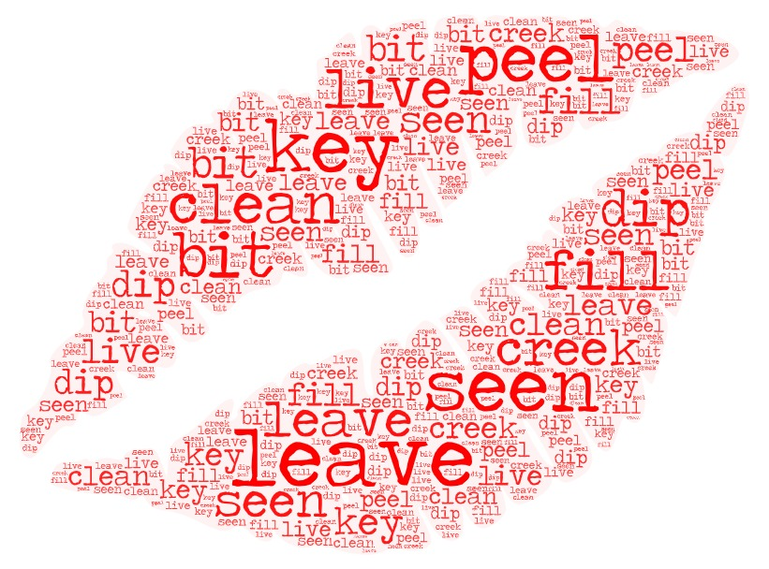
match words and sounds [ i: ] [ i ]

Slide 2

Составьте предложение

Slide 3
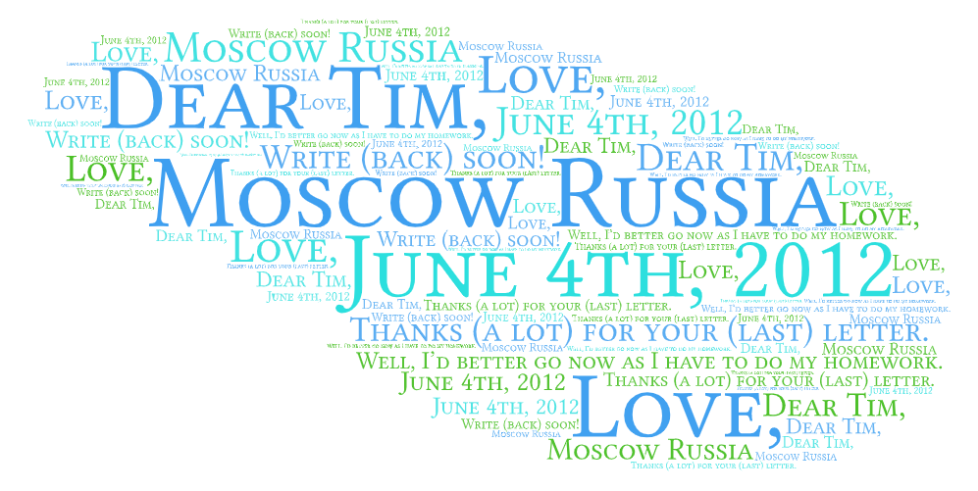
Адрес в кратком виде:
Под адресом, пропустив строку, мы пишем:
Обращение:
В первом абзаце (благодарность):
В последнем параграфе, объяснение почему заканчиваем:
Упомяните о дальнейших контактах:
Завершающая фраза-клише:

Slide 4

Past Continuous
Past Perfect
Past Perfect Continuous

Slide 5

Find synonyms

Slide 6
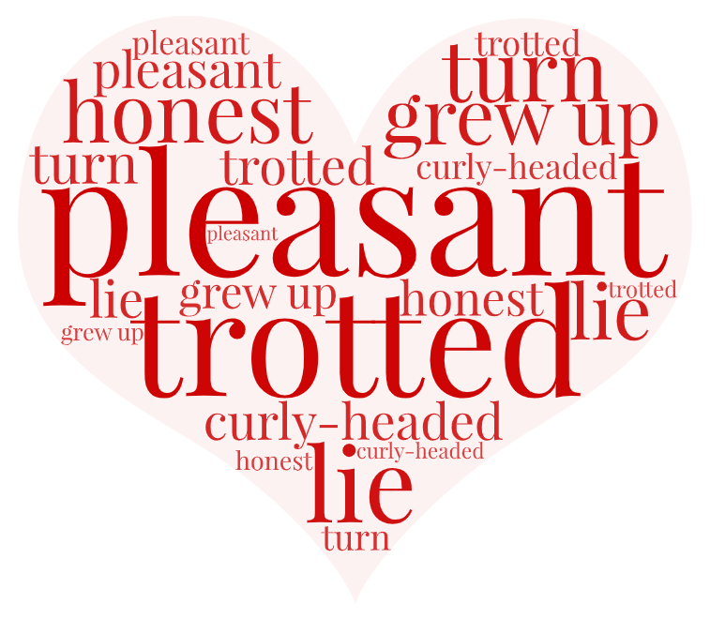
The Boy Who Never Told a Lie.
Once there was a little boy,
With curly hair and … eye -
A boy who always told the truth,
And never, never told a lie.
And when he … off to school,
The children all about would cry,
’There goes the … boy -
The boy that never tells a lie.’
And everybody loved him so,
Because he always told the truth,
That every day, as he … ,
’Twas said, ‘There goes the … youth.’
And when the people that stood near
Would … to ask the reason why,
The answer would be always this:
’Because he never tells a … .

Slide 7

(1)…Ted Shell is (2) ... worker. He works at (3)... factory. It’s not in (4) ... center of the city. Every morning he has (5)... breakfast and (6) ... cup of tea. Then he goes to (7)... work by (8)... bus. He works till five o’clock in (9)... afternoon. He has (10)... son. His name is Fred. Fred goes to (11)... school. He likes (12) ... literature. Fred is (13)... good pupil. He also likes (14) ... sports.
Where does ted work?
How long does he work?
What are Fred's hobbies?
Who is Fred?

Slide 8
